Slide 1
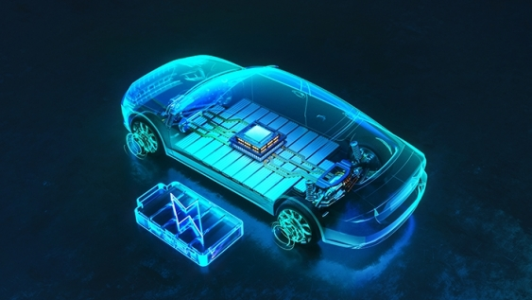

DEVELOPMENT OF A 3-PHASE MOTOR DRIVE INVERTER FOR ELECTRIC VEHICLES
AUTHOR: MINCILI NELANI
SUPERVISOR: PROFESSOR PAUL BARENDSE
DEPARTMENT OF ELECTRICAL ENGINEERING, 2024

Slide 2
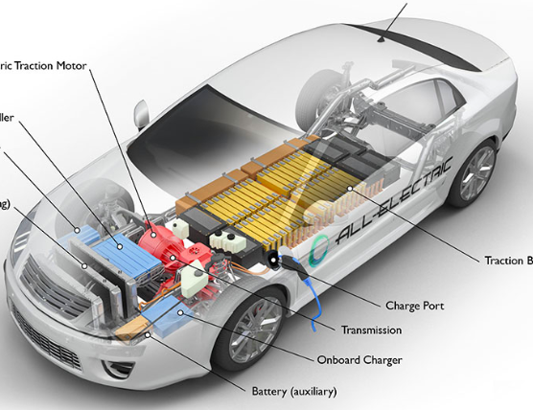
Importance: Optimizing motor performance for sustainable transportation.
Objective: Develop a V/Hz-controlled inverter for induction motors(IM) in electric vehicles (EVs).
Method: Simulation and practical testing (MATLAB/Simulink, dSPACE, LabVIEW).
Diagram of an electric vehicle's powertrain. Adapted from U. D. o. Energy, “How Do All-Electric Cars Work?” [Online]. Available: afdc.energy.gov. [Accessed 19 October 2024].

Slide 3
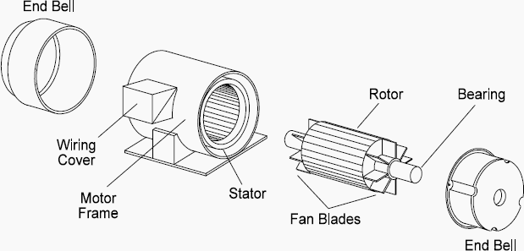
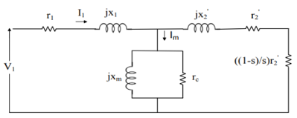
Induction motor components and equivalent circuit
Main components of an induction motor. Adapted from S. J. Chapman, Electric Machinery Fundamentals, 4th ed., 2010.
Equivalent circuit of a three-phase induction motor. Adapted from “Equivalent Circuit of Three-Phase Induction Motor,” [Online]. Available: electricallab.in. [Accessed 18 October 2024].

Slide 4
Im Speed control methods
Pole Changing
Line Voltage Control
Rotor Resistance
Line Frequency Control

Slide 5
Control Techniques
Open-loop V/Hz (Scalar Control)
Closed-loop V/Hz
Vector Control
Torque Control

Slide 6
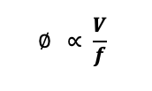
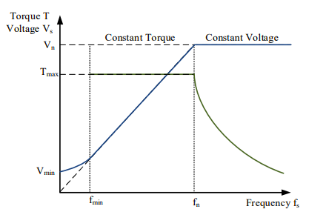
V/HZ CONTROL
Simple
Low-cost speed control

Slide 7
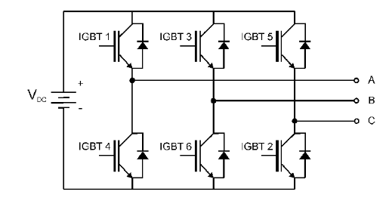
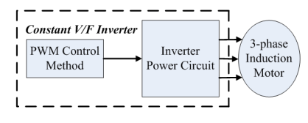
V/hz simulation implementation
S. G. S. M. P. Sapna, “A Simplified V/F Control Strategy for Induction Motors in Electric Vehicles,” IOP Conf. Ser.: Mater. Sci. Eng., pp. 1-6, 2021.
3-phase Inverter Circuit
Tools Used: MATLAB Simulink model.
Model Details:
Frequency ramp input (0-50 Hz).
PWM signal generation (2000 Hz).
Sinusoidal Pulse Width Modulation (SPWM).

Slide 8
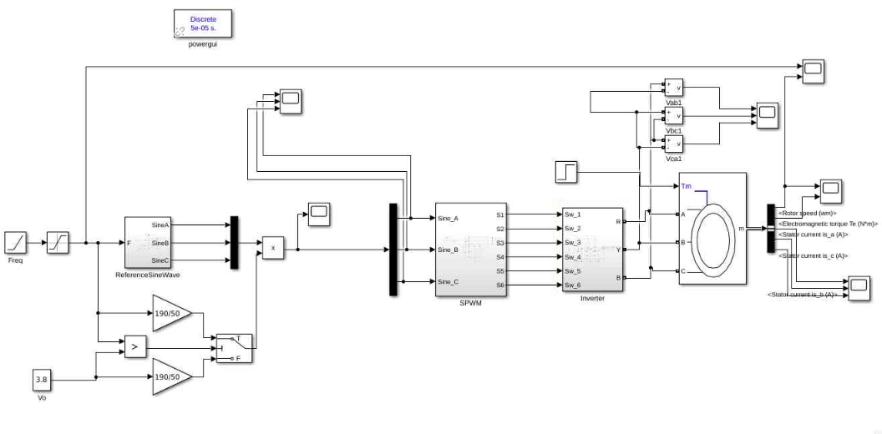
V/hz simulation implementation

Slide 9
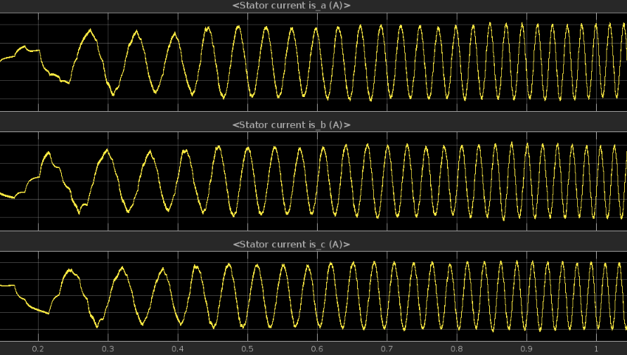
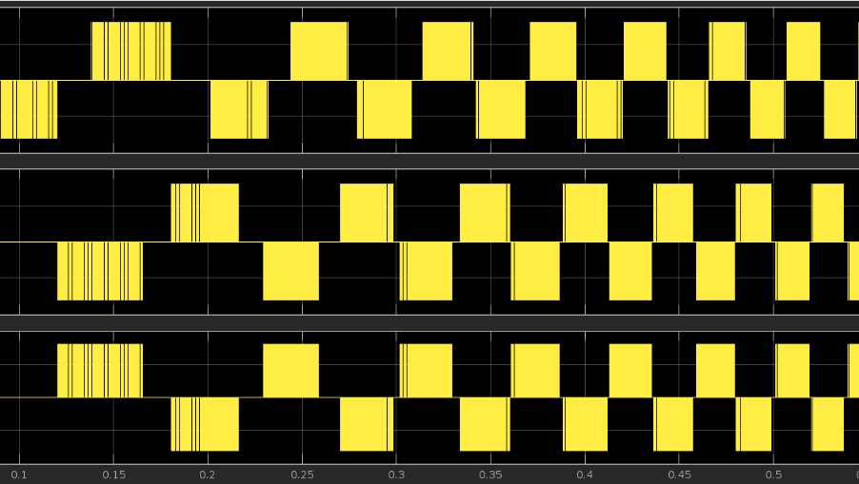
Simulation results
Generated Sine Waves
SPWM driven AC output to IM

Slide 10
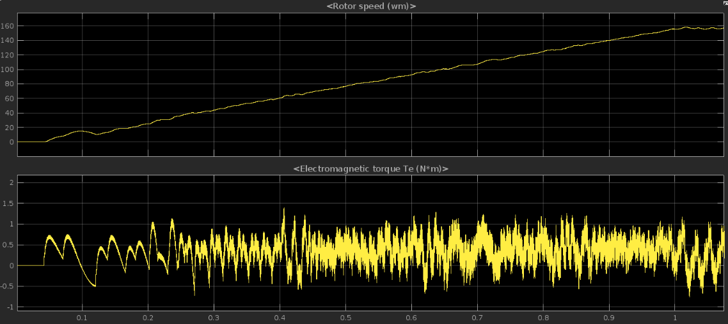
Simulation results
Rotor Speed vs Torque

Slide 11
V/hz simulation implementation (key observations)
Speed increases linearly with frequency.
Torque oscillations noted, especially under load changes.
Impact of No Filter: Noise introduced instability.

Slide 12
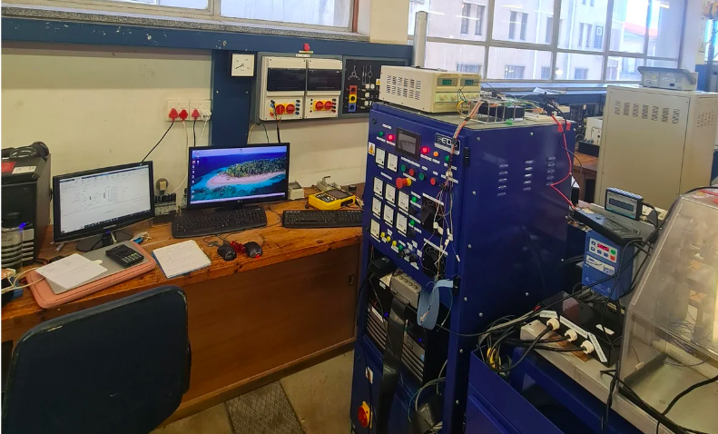
Practical implementation (set up)
Inverter and Rectifier
LabVIEW
DSPACE
Control desk
Control Panel

Slide 13
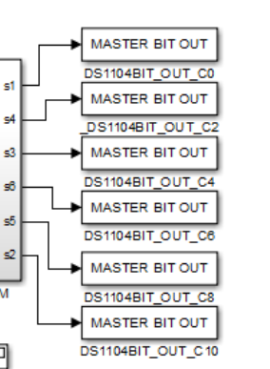
Practical implementation (set up)
Setup:
dSPACE DS1104, DC supply, three-phase inverter and IM.
SPWM signals to IGBT switches, AC supply for motor.

Slide 14
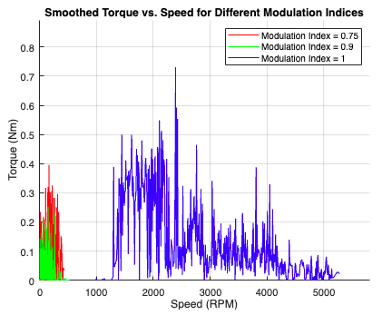
Labview results

Slide 15
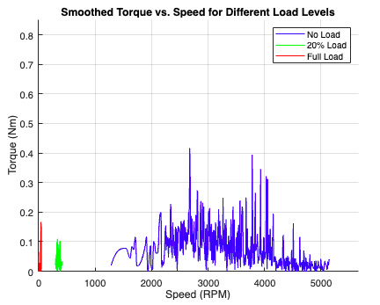
Labview results

Slide 16
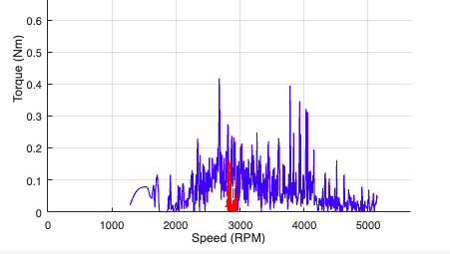
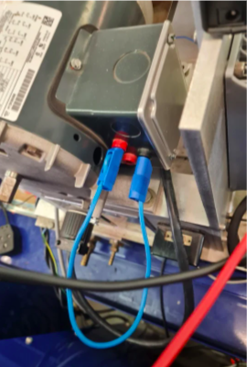
Labview results (stator inter-turn fault)

Slide 17
observations
Limitations Observed:
Significant speed drop under load.
Noise Impact: No filter led to instability.
A lot of hardware debugging.
Findings:
Open-loop V/f control is cost-effective but imprecise.
Speed and torque variations under load and fault settings.
Torque Oscillations: Notable, especially at startup.
Application Suitability:
Effective for low-precision settings, but not high-performance.

Slide 18

Dc-bus analysis
Objective
Evaluate battery health impact
Harmonics Analysis:
Observed current and voltage ripples (LabVIEW, FFT).
Insights:
High ripple potentially affects battery aging, particularly at low charge states

Slide 19
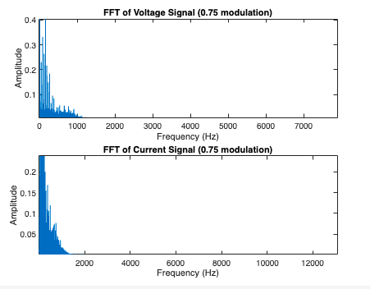
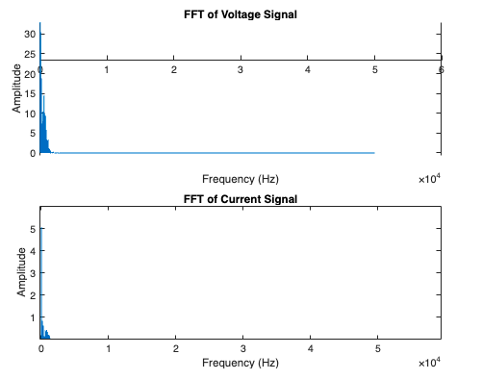
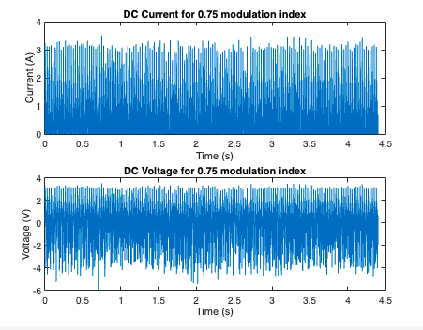
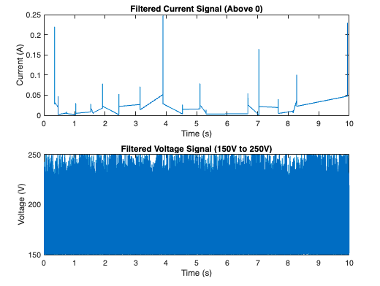
Dc bus analysis (fft results)

Slide 20
Conclusion and future work
Conclusion:
Open-loop V/f suitable for simple applications, but lacks precision.
Future Work:
Closed-loop control and advanced PWM techniques.
Potential improvements in EV battery lifespan with better control and filtering.

